Slide 1
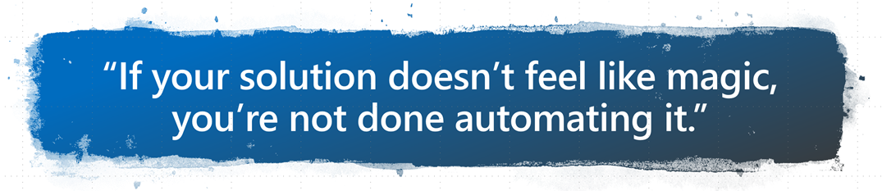

DevOPS for Office365DSC
Keeping Multiple Tenants in Sync
Nik Charlebois – Senior Premier Field Engineer

Slide 2








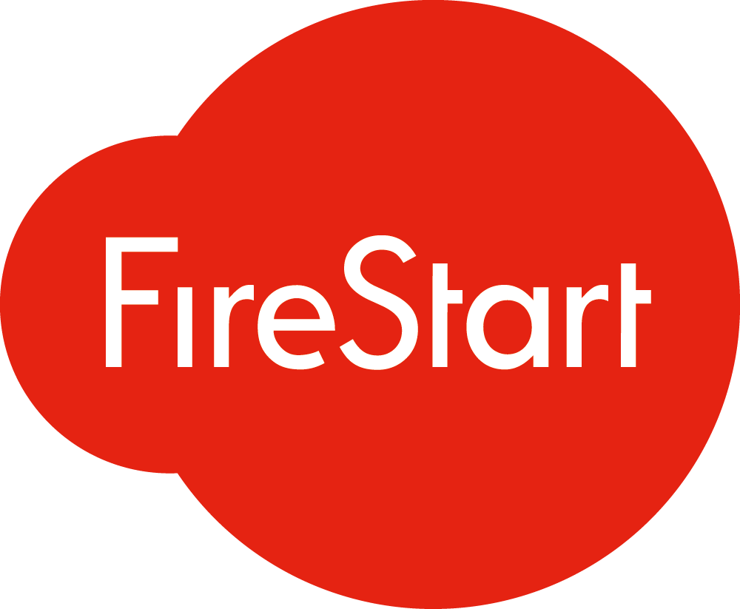









Our Sponsors
Gold
Uranium
Diamond
Platinum
Silver

Slide 3

SharePint
Duke of Sussex
23 Baylis Road
London
SE1 7AY

Slide 4

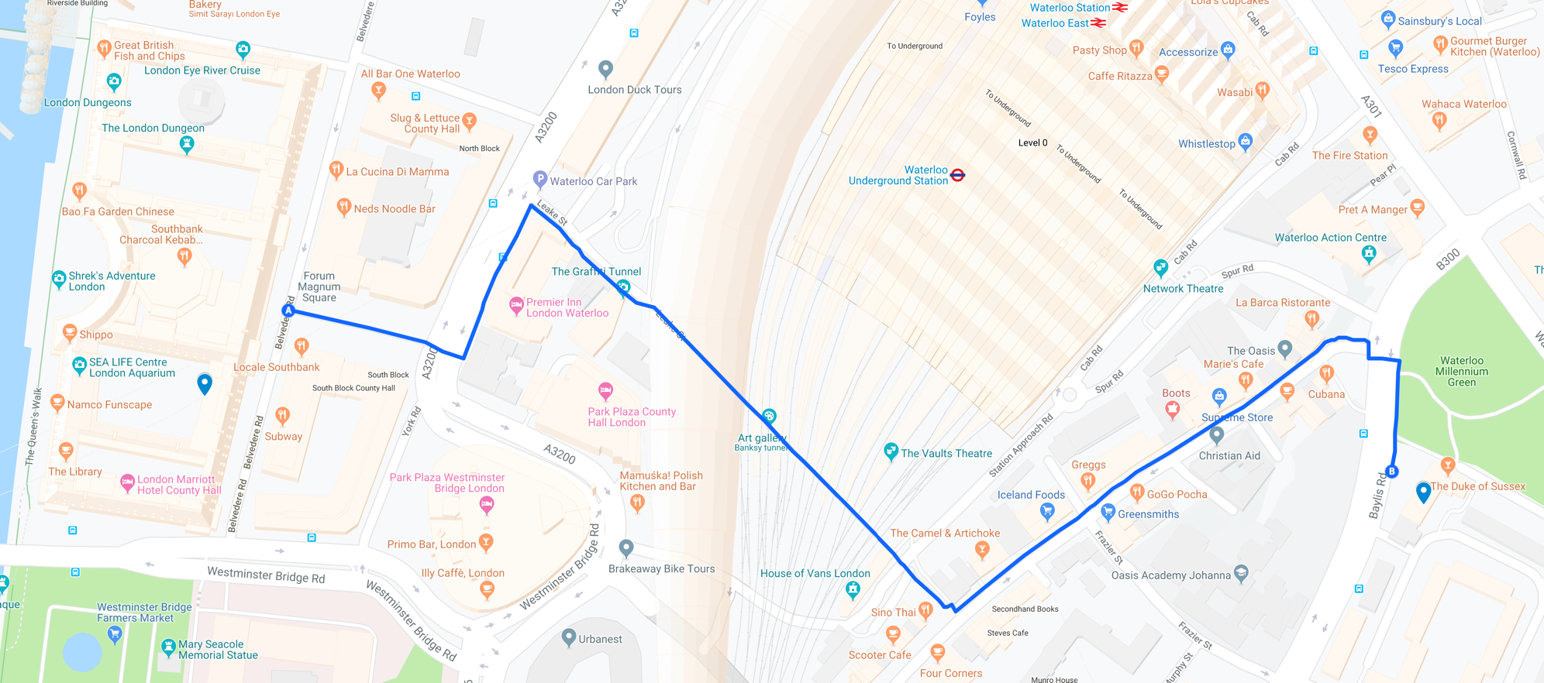
SharePint

Slide 5
Demos & Content All Demos and Slides are available at: https://aka.ms/SPSLondon2019

Slide 6
PowerShell Desired State Configuration for Office365
PowerShell DSC allows organizations to automate the deployments, configuration and monitoring of their environment using Configuration as Code. This means that traditional IT Pros work can now be integrated as part of an enterprise DevOPS pipeline. With its baked in ReverseDSC components, Office365DSC allows organizations to ensure their various tenants configuration are in sync. In this session, we will give you an overview of how you can use DSC to manage SharePoint Online workloads, monitor configuration drifts, and extract configurations out of existing environments.

Slide 7

‏@NikCharlebois
Microsoft Senior Premier Field Engineer
Focusing on DevOPS & Automation
About Me
Ex-MVP PowerShell
Book Author: Beginning PowerShell for SharePoint 2013 and 2016 & Office 365 Experts
Based in Gatineau, Québec
Blogger at http://NikCharlebois.com
Creator and Owner of:
Office365DSC
ReverseDSC
Co-owner of :
SharePointDSC
2 kids

Slide 8
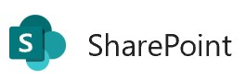
Managing Expectations
Very technical session
We’ll take about 15 minutes to do an introduction to DSC;
Please ask your questions as we go;

Slide 9
Agenda
Overview of PowerShell DSC;
ReverseDSC in action;
Introduction to Office365DSC;
Azure DevOPS & Integration scenarios for Office 365;

Slide 10
Desired State Configuration

Slide 11
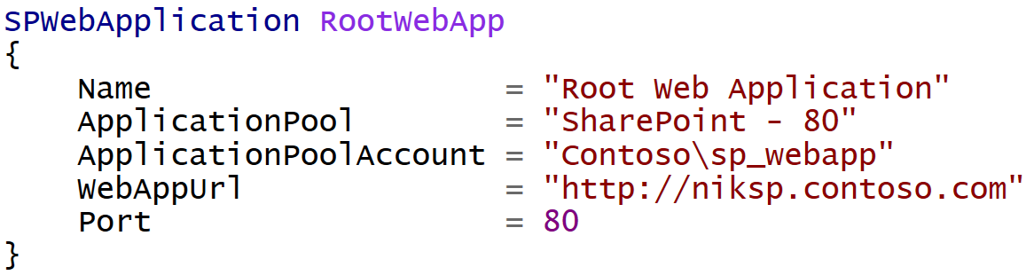
Difference with Classic PowerShell
It’s a Declarative approach;
Notes:
Meaning I don’t tell it do this and then that, but rather here is how I want this, then do whatever in you need to to get me there

Slide 12
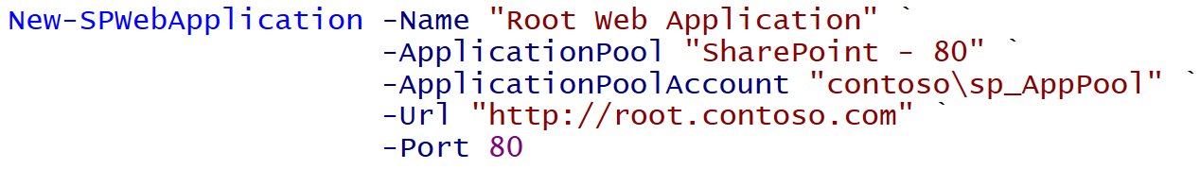
Imperative
Declarative
Notes:
Same result. Yes more lines in this example, but ensures it stays in that state.

Slide 13

PowerShell DSC (10,000 feet overview)
Deployment Automation and monitoring solution;
Ensures that environments stay in their Desired State;
PowerShell 4.0 and above (therefore no support for SP2010);

Slide 14
Monitoring Configuration Drifts
Configuration Modes:
ApplyOnly
ApplyAndMonitor
ApplyAndAutoCorrect

Slide 15
Monitoring Configuration Drifts
Configuration Modes:
ApplyOnly
ApplyAndMonitor
ApplyAndAutoCorrect
Configure server as specified, then done.;
Equivalent to using sequential scripts (or AutoSPInstaller).

Slide 16
Monitoring Configuration Drifts
Configuration Modes:
ApplyOnly
ApplyAndMonitor
ApplyAndAutoCorrect
Monitors Configuration Drifts;
Logs drifts in Event Viewer;

Slide 17
Monitoring Configuration Drifts
Configuration Modes:
ApplyOnly
ApplyAndMonitor
ApplyAndAutoCorrect
Monitors Configuration Drifts;
Automatically fixes drifts.

Slide 18
Ensure
DSC is not only about making sure that certain components are configured on a sever;
Every resource has a parameter Ensure exposed;
Setting Ensure = Absent makes sure that the specified component is NEVER configured on the server;
Hard to define all “non-config” scenarios….it’s actually impossible;
SPServiceInstance SearchAdmin
{
Name = "WSSSearch"
Ensure = "Absent"
}

Slide 19

DSC Modules
Macro components that extend the reach of DSC (e.g. SharePointDSC, SQLServerDSC, etc.)
All available on the PowerShell Gallery (http://PowerShellGallery.com)

Slide 20
Demo 1
Managed Paths with DSC

Slide 21
ReverseDSC

Slide 22
Internal Logic of DSC Resources
Test – » Am I in my Desired State ?
Get – » How am I currently configured?
Set – » Bring me into my Desired State!

Slide 23
ApplyAndAutocorrect Flow

Slide 24

ReverseDSC
Extract DSC Configuration from existing environments.
Framework that requires a technology specific Orchestrator to operate..
ReverseDSC Orchestrator for SharePoint is available on the PowerShell Gallery;
Install-Script SharePointDSC.Reverse

Slide 25
ReverseDSC Scenarios
Recreating an environment for Troubleshooting;
Point-in-time snapshot;
Delta Analysis;
Disaster Recovery;
On-boarding existing environment onto DSC for monitoring;
Keeping environments in-sync;

Slide 26
Demo 2
ReverseDSC for SharePoint

Slide 27
Office365DSC

Slide 28







Office365DSC
Will support all Office 365 Workloads:
PowerApps
Flow […]
Still in the early development phases
Aka.ms/Office365DSC

Slide 29
Office365DSC
Visit wiki for details on current workloads
Aka.ms/Office365DSCWiki

Slide 30

Office365DSC
Create new site collections, new Teams & Channels, manage groups, users and licenses, etc.
Allows for integration between Office 365 Configs and Azure DevOPS;
Makes it easy to configure multiple tenants the same;

Slide 31
Office365DSC
Help wanted
Testing
Development
Suggestions and ideas
Please visit Github site
Aka.ms/Office365DSC

Slide 32
Demo 3
Teams Deployment

Slide 33
Demo 4
Tenants Synchronization

Slide 34
Azure Automation

Slide 35


Pull Server
Central server that stores all configurations for your enterprise (e.g. WFE, SQLServer, DC, etc.)c
Pull Server

Slide 36
Pull Server
Central server that stores all configurations for your enterprise (e.g. WFE, SQLServer, DC, etc.)
Pull Server

Slide 37

Overview of AADSC
Pull Server as a Service;
Included as part of an Azure Automation Account;
Free when used with Azure VMs;

Slide 38


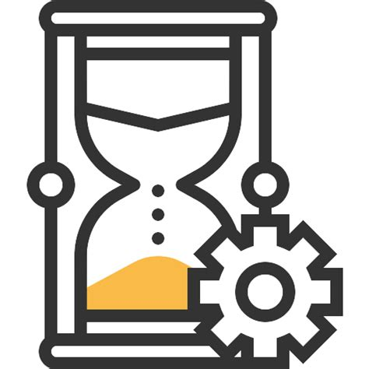
Overview of AADSC[…]
Azure Virtual Machine
DSC Script
Azure Automation

Slide 39
Demo 5
Azure Automation - Firewall Rule

Slide 40
Demo 6
Azure Automation for Office 365 Monitoring

Slide 41
Azure DevOPS

Slide 42

Azure DevOPS
Manage your Office 365 configuration as code;
Automate deployments upon configuration changes;
DevOPS at its best!
Challenge is to convince IT Pros to use it.

Slide 43
Demo 7
Azure DevOPS for Office 365

Slide 44
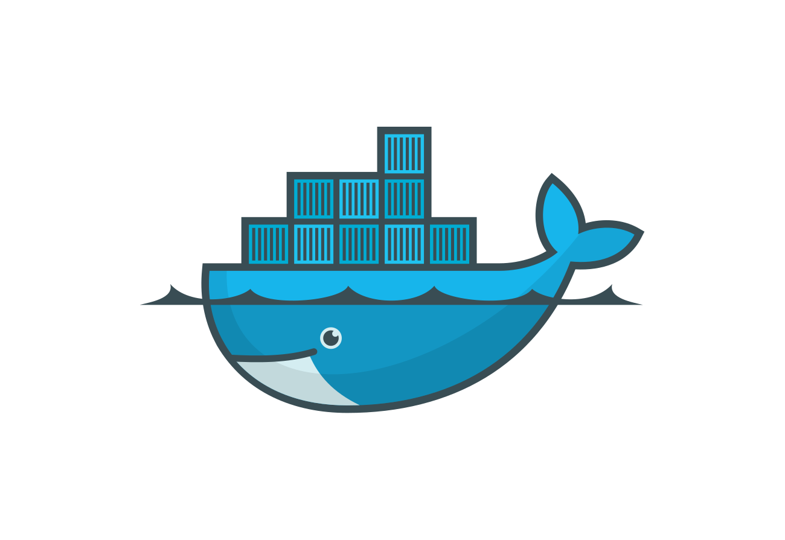

SaaS Paradigm
Effet Middle-Man;
Azure DevOPS Build Agent;
Azure Container Instance;
Azure Jobs & Batch;
LCM-as-a-Service

Slide 45
Questions

